Slide 1
JUPITER 105-OC Project

Slide 2

Problem Statement
Dealing with bulk data of Employees which makes difficult to access each and every employee details and also difficult to allocate BU DU OU.
Main Stakeholders are RM team(Resource Management).

Slide 3
Introduction
To manually allocate BU DU OU to each and every employee is troublesome
To make it uncomplicated or effortless we made a UI application.
Using this application we can assign respective units to any employee.
We can even download all employees details into excel sheet.

Slide 4
Technical Components
React JS
Java Script
JSON
Node JS

Slide 5
Architecture
Application
{Front_End}
<<Components>>
1.EditEmpData
2.EmployeeTable
3.EmployeesList
{Back_End}
<<Data Base>>
1.employee.json
2.Server.js(API)

Slide 6
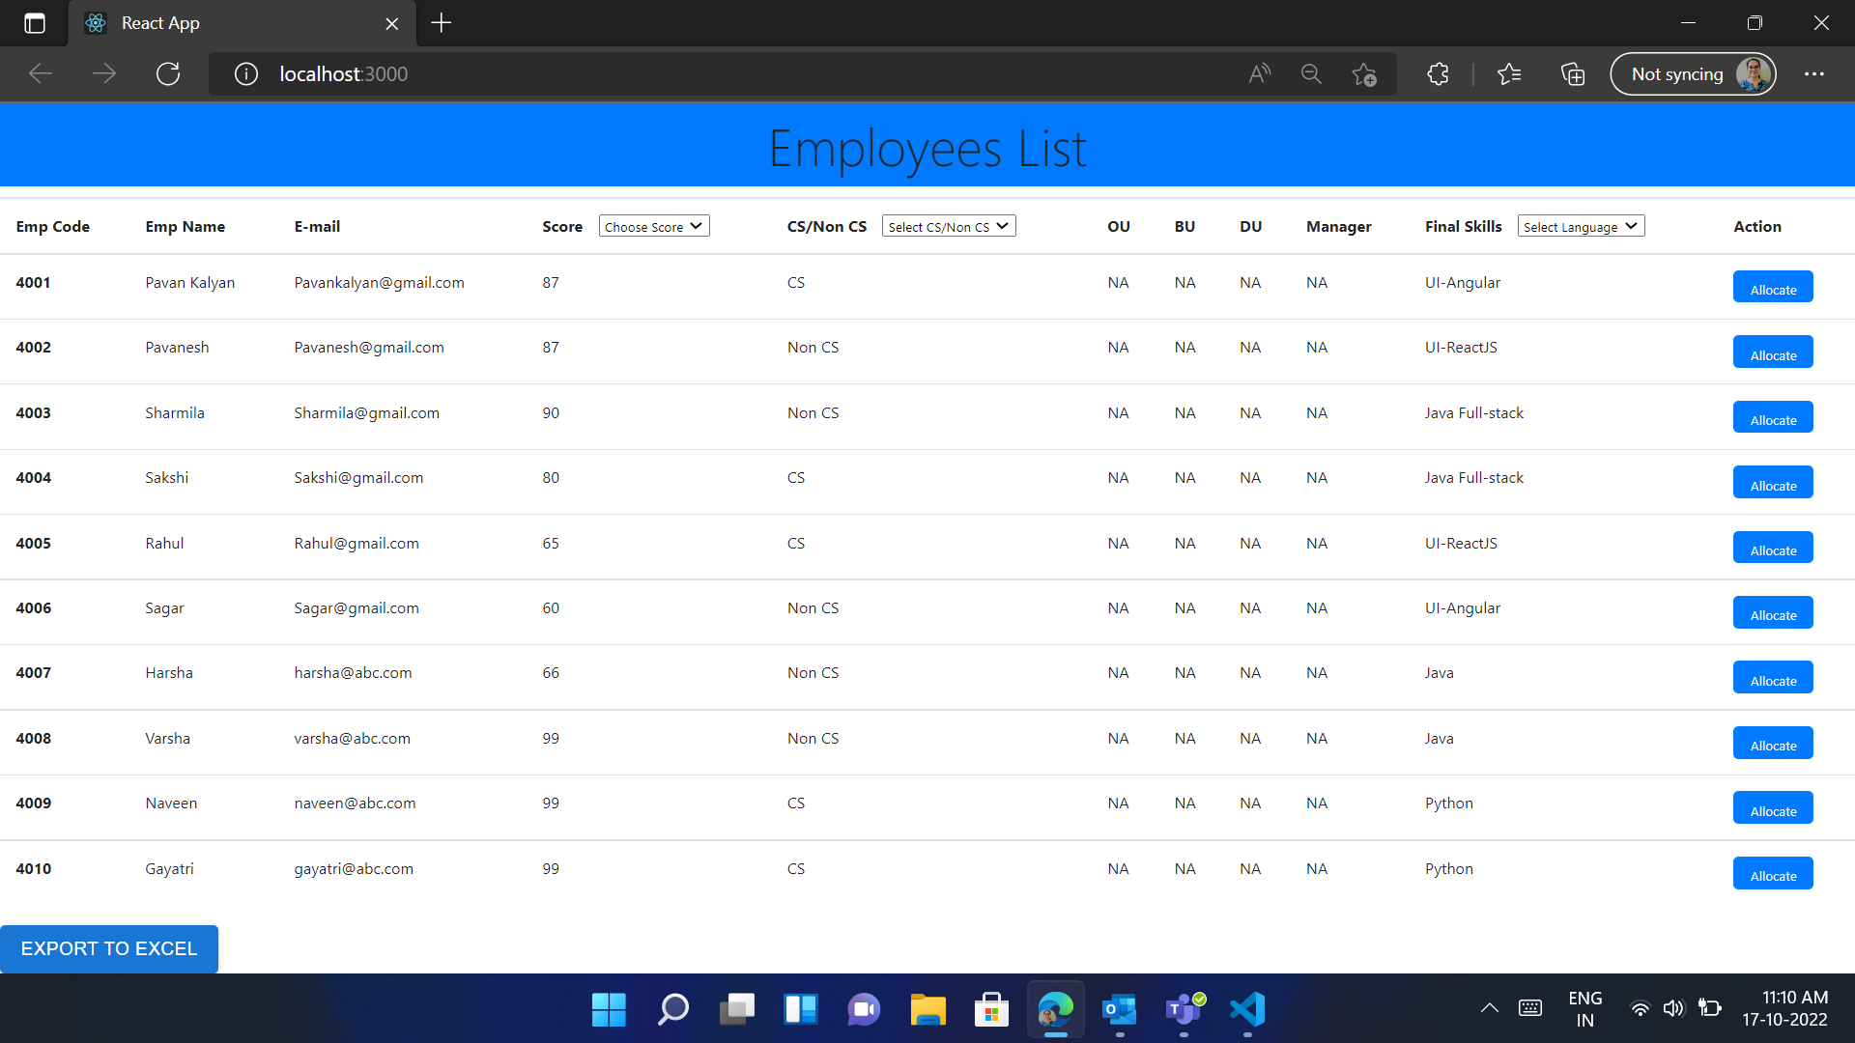
Main Page where all Employees details are displayed.

Slide 7
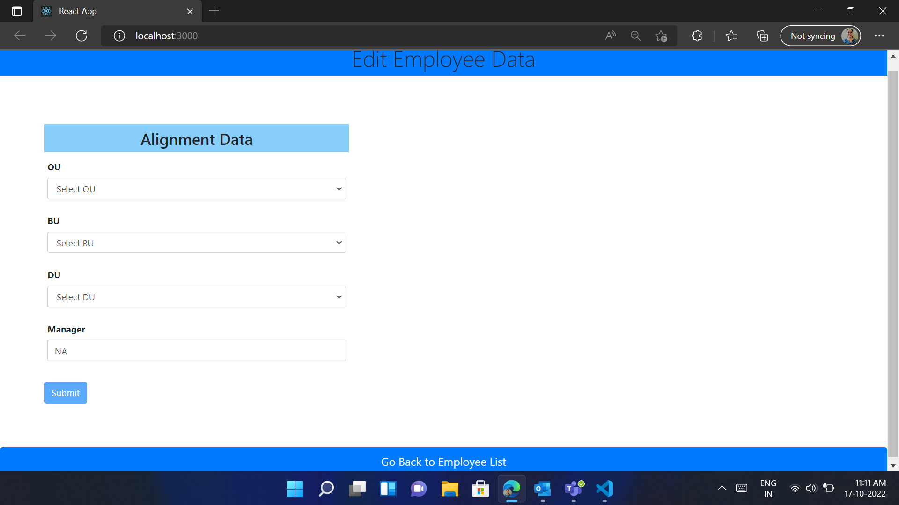
Here respective units will be allocated to employees.

Slide 8
Demo

Slide 9
Contributions to Work
FrontEnd – React/ Angular
Sakshi Verma
Rahul Geddam
Pavanesh T
Pavan Gajji
Betha Kumar
BackEnd – API(Node JS)
Ragu Madhuri
Suharsha Nuthula
Srujana Remalli
Satti Amrutha
Mohammad Sharmila
Ravanam Thanooz
Udaya Laxmi Nagubandi
Vippala Manikanta
Athanti Sai Sruthi
JSON Data
M.A. Waseem Shoaib
Sai Srija Indukuri
Bodasingi Naveen Kumar
Cheekatla Manikanta Sai

Slide 10
THANK YOU !

